Slide 1
Specialized Connective Tissue
(cartilage and bone)

Slide 2
Specialized Connective Tissue * Include : Skeletal connective tissue (cartilage and bone).

Slide 3
skeletal connective tissue:
Cartilage: is a flexible connective tissue that keeps joint motion fluid by coating the surfaces of the bones in our joints, cartilage functions to provide support and maintain the shape of flexible body parts like our ears and larynx.
Cartilage consists of:
Hyaline cartilage
Elastic Cartilage
Fibro cartilage

Slide 4
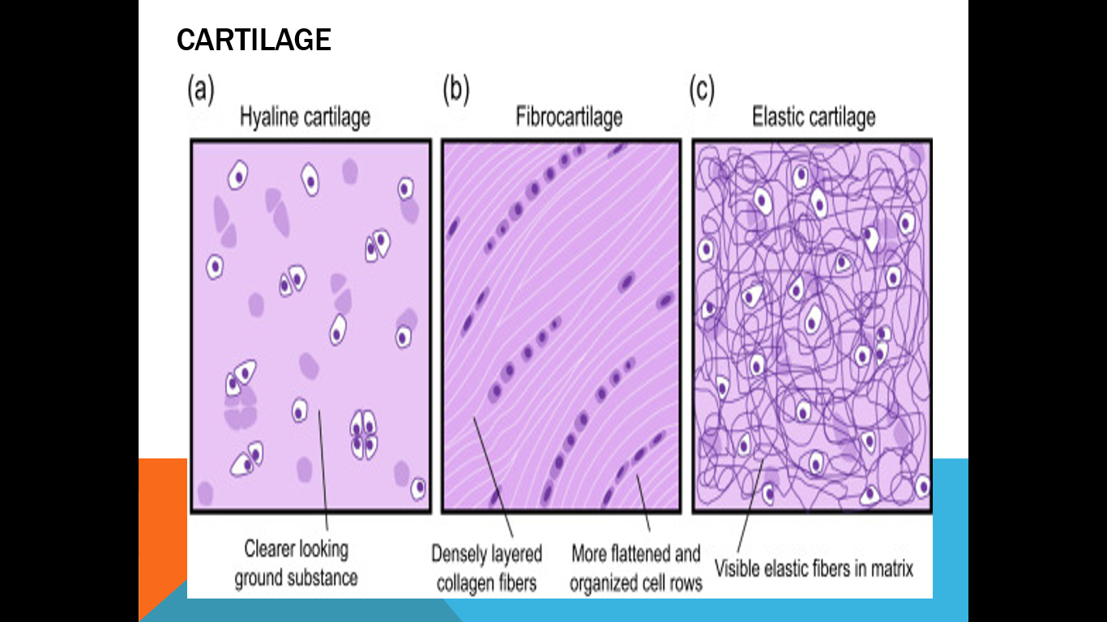

Slide 5
Hyaline cartilage
It is a transparent type of cartilage found on the surfaces of many joints, does not contain nerves or blood vessels, and its composition is relatively simple, It is also most commonly found in the ribs, nose, larynx, and trachea, It is composed of chondrocytes that exist singly or in groups within a lacuna, and surrounded by a capsule called perichondrium.

Slide 6
Elastic cartilage
is found in the ear, It is similar to Hyaline cartilage but it is more flexible due to the large presence of the yellow fibers in the matrix , and it is contains of perichondrium.

Slide 7
Fibro cartilage
is found in the discs between the vertebrae (an inter vertebral material), that is characterized by containing bundles of white fibers parallel to each other, and does not contain perichondrium.

Slide 8
Bone
Bone is a specialized connective tissue consisting of osteocytes within lacuna and matrix consisting of organic materials (white fibers) and inorganic material (minerals….) which give strength and rigidity to the bone , the bones are of two types:
Compact bone
Spongy bone

Slide 10
Compact bone
Osteocytes are arranged in circles called bone lamella that revolve around a central channel called the Haversian canal ,both plates and the channel together called as the Haversian system.The bone is surrounded by Periosteum, and Haversian systems are connected together and with the bone periosteum by transverse channels called Volkmann’s canals.

Slide 11
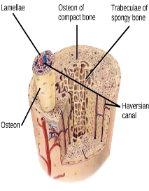

Slide 12
Spongy bone
It is bone tissue that contains large spaces filled with bone marrow (red blood cells and fat cells) surrounded by bone material of different sizes and shapes consist of osteocytes.

